Slide 1

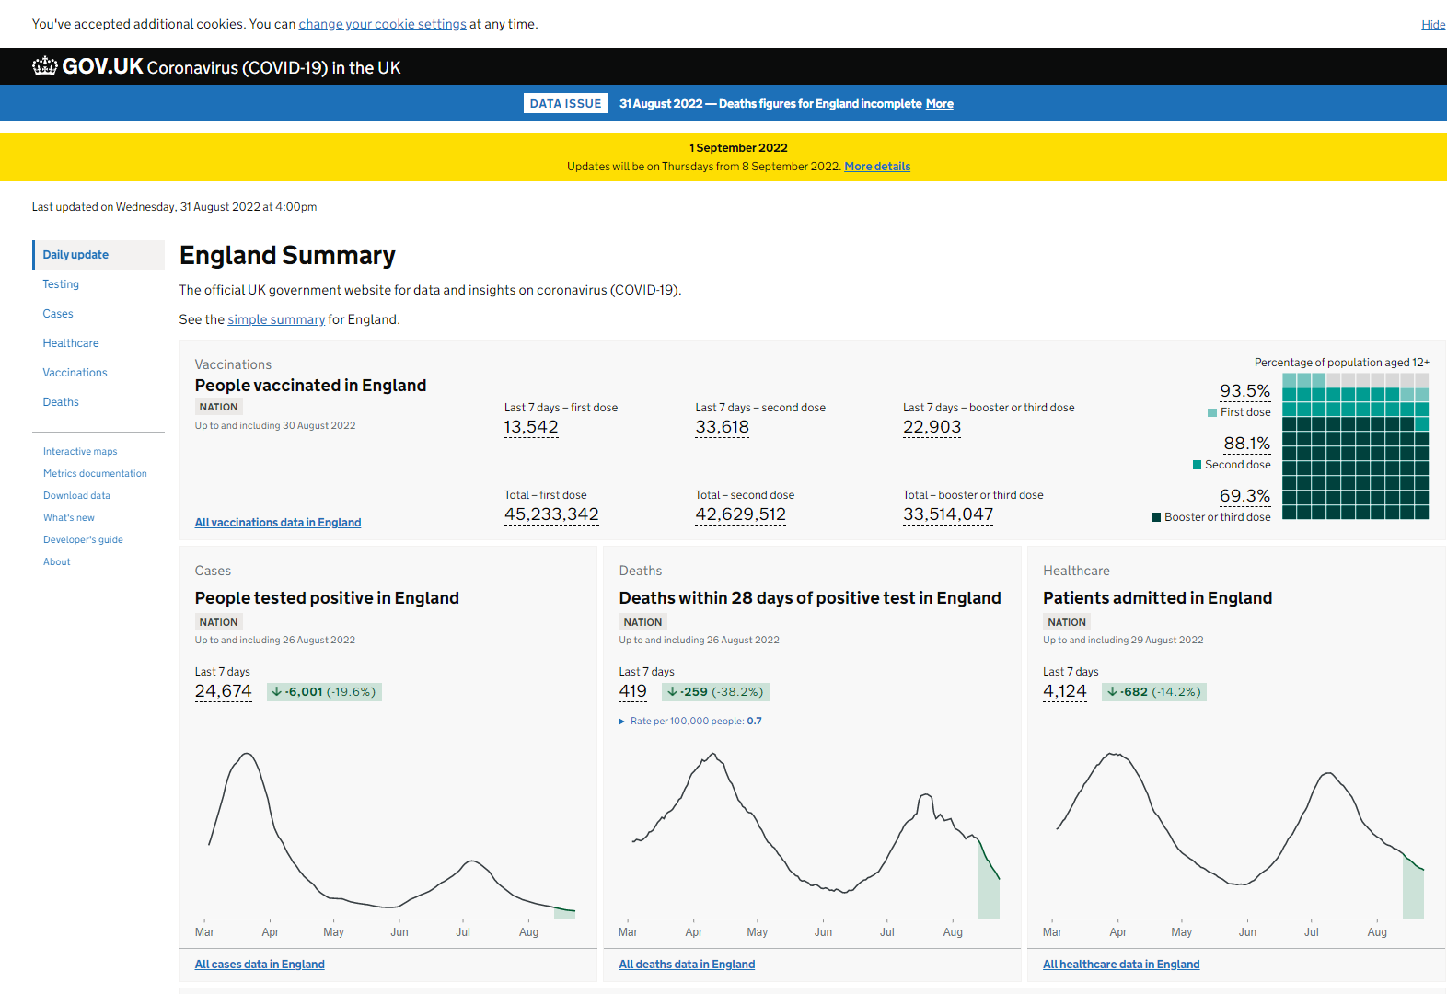
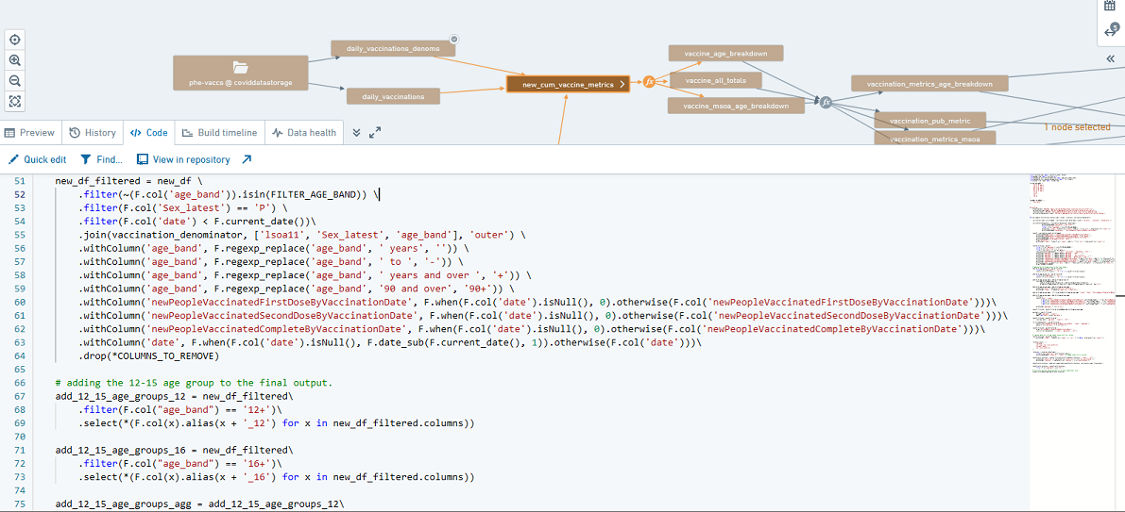
Developing the UK COVID-19 Dashboard – challenges and lessons learned
Authors: Clare Griffiths², Alyson O’Neill¹, James Westwood², David Jephson¹, Pouria Hadjibagheri²
1 Office for Health Improvement and Disparities, Department for Health and Social Care; 2 UK Health Security Agency
INTRODUCTION
CHALLENGES
LESSONS LEARNED
SUMMARY/CONCLUSIONS
The Coronavirus (COVID-19) in the UK Dashboard is the official UK government website for COVID-19 data, providing a single source of essential data and statistics (Figure 1). It was rapidly developed in 2020 in response to the evolving pandemic. Usage reached up to 1 million unique users and 70 million hits per day.
Challenges and lessons learned from UKHSA’s experience of developing the dashboard will be valuable for informing future products. A recent study explored the development of COVID-19 dashboards across Europe during the first year of the pandemic and identified common barriers, enablers and lessons learned. Representatives from the UK COVID-19 Dashboard took part in this study.
Here we highlight some of the key challenges faced and the lessons learned from the work of the UK Health Security Agency COVID-19 Dashboard Team.
1. Data volume - the sheer volume of data involved in producing the metrics is a major challenge. Data comes from over 26 separate sources, providing in excess of 700 million raw figures to handle each day
2. Daily surge in demand - each day at 16:00, the level of demand on the dashboard would surge as people tried to access the website. This put enormous pressure on the stability of the site and required constant monitoring and activity to prevent service failure. Actions included increasing database base capacity, optimising key parts of the code, and implementing multiple layers of caching.
3. Creating UK Data – the UKHSA collaborates across the nations to provide a single UK figure for as many of the metrics as possible. This brought numerous challenges with each of the 4 nations working to different timescales and collecting data in different formats. For example, recently, Department of Health Northern Ireland ceased reporting on cases, deaths and testing (effective 20 May 2022) meaning we were unable to generate UK headline figures beyond that date. With two days’ notice, the team worked rapidly to repurpose the dashboard homepage, altering it from presenting UK summary data to England only figures/charts.
1. The value of feedback and robust user research
We receive a lot of feedback via various routes (such as user surveys, user testing and emails to our feedback mailbox). All of which, be it negative or positive, is valuable and can and has been used to:
inform the design of user research sessions
improve robustness of standard operating procedures (SOPs)
improve quality assurance processes
improve overall design and the ‘user experience’
2. Being open builds trust
Data is provided in an open format, allowing access to millions of people and helping them understand Government decisions. Being so open builds trust (as evidenced by our user surveys reporting high levels of trust in the dashboard) and allows us to rapidly identify mistakes (as users are quick to provide feedback). There are however some downsides to this approach as detailed in Box 1.:
3. The need for Reproducible Analytical Pipelines (RAP)
RAP is essential for handling large volumes of data rapidly. The data pipeline began on NHS Foundry and iteratively expanded over time to several hundred transforms covering billions of data points, from numerous different disparate sources. There are many benefits to this approach, for example:
ability to produce a large number of metrics within tight time scales by providing a reliable foundation for daily processing
improved error checking made via a modular approach, making it easier to identify the source of issues and fix more quickly
ability to iterate over time to improve efficiency and also test on branch first to ensure functioning as required
formalisation of all our pipelines on the system ensures that everything is documented completely and in one place
collaboration between organisations through access to each other's pipelines
When planning a dashboard, work should focus across 3 areas; statistical, engineering, and the digital/user journey. All 3 are of equal influence/importance for building a successful, sustainable product.
A large contributing factor to reaching high levels of public engagement can be attributed to the quality of engineering, statistics and the user interface which have been developed and designed in response to regular user feedback.
Public health advice and government decisions will continue to be informed through the COVID-19 Dashboard and UKHSA will also maintain our other critical surveillance capabilities to monitor the virus. As we move forward and continue to monitor COVID-19 closely, the frequency of reporting data on the COVID-19 Dashboard will be kept under review.
Box 1: Downsides to open format data
room for misinterpretation – for example, on several occasions the media reported incorrect information which then needed to be rapidly responded to and corrected pressure to publish as soon as possible – publishing daily to such high demand and over a prolonged period is difficult to sustain for small team of staff limited time for quality assurance – the pace of turnaround to meet the 4pm deadline leaves little time for detailed quality checks. Any mistakes are quick to be identified (for example media reporting our daily figures within minutes of them being released) no room for delays – once expectation is set, it is hard to move away from this – people depend on the information, for example in planning their daily activities and making travel arrangements
REFERENCES
Barbazza E, Ivankovic D, Davtyan K. et al (2022) The experiences of 33 national COVID-19 dashboard teams during the first year of the pandemic in the World Health Organization European Region: A qualitative study. Digital Health, 8 (1-16).
ACKNOWLEDGEMENTS
We would like to thank all current and former COVID-19 Dashboard Team members for their contributions to this work, in particular:
Flora Death Hayder Aziz Molly Kelly Anxo Roibas
Bea Goble Carol Davies Russell Plunkett Marta Fioni
Eva Mitchell Nick Jones Anita Brock Rachel Roche
Julian Flowers Paul Fryers Daniel West Meaghan Kall
Anne Marie O’Connell
Thanks also to the organisations without whom the Dashboard would not be possible:
UKHSA / Public Health England / NHS Test and Trace
Office for Health Improvement and Disparities
NHS England and Improvement
NHS Arden & GEM Commissioning Support Unit
Department of Health and Social Care
National statistics organisations across the UK nations
Devolved administrations
Palantir
Microsoft and Microsoft Azure support team, especially the Customer Success Unit (CSU) and the Citus team
Figure1: The UK COVID-19 Dashboard Homepage
Figure2: Some of the pipeline code

